Slide 1

Task 3.1 State-of-the-Art, Threat model and Technical Specifications
WP3 Third Meeting
12 02 2025
ICCS

Slide 2
Single Model Paradigm

Slide 3
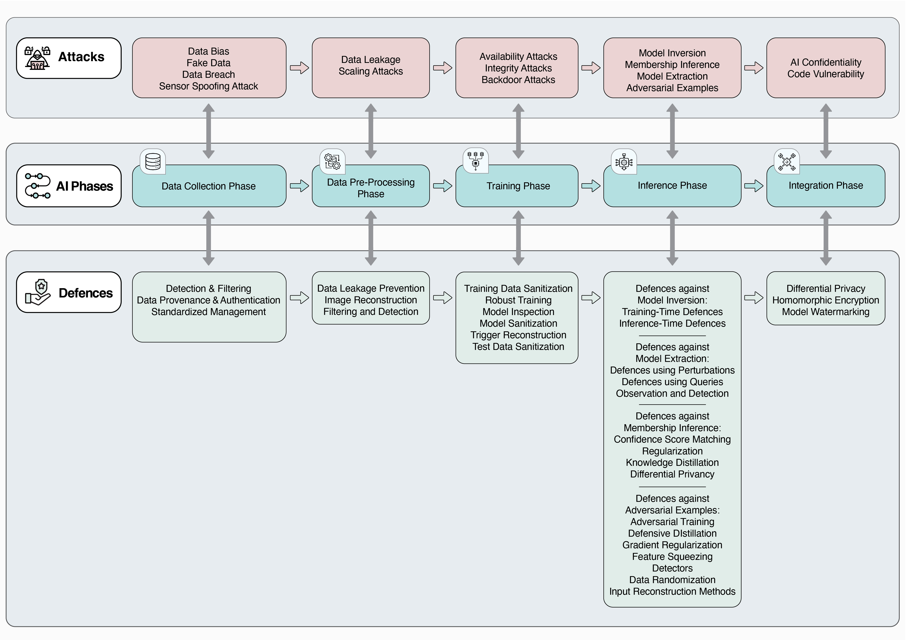

Slide 4
Data Collection phase

Slide 5
Data Collection phase - Overview
Data is the driving force behind the rapid development of AI.
Data Collection can be categorized into:
Software-based data collection: relies on tools like crawlers, where vulnerabilities in any component can compromise data quality.
Hardware-based data collection: Sensors are the most widely used data collection tools, however, sensor data collection is, for example, vulnerable to security threats such as sensor spoofing attacks.
In such attacks, an attacker gains access to or tampers with the data provided by the sensors. In other words, an attack targets the sensors in a system to manipulate or deceive their readings, as a result to manipulate the data.

Slide 6
Data Collection phase - Attacks
Data Bias
Fake Data
Data Breach
Sensor Spoofing Attack

Slide 7
Data Collection phase – Attacks
Data Bias
AI is very sensitive to training data.
Data source selection and data preparation may introduce bias.
Data bias occurs when the collected data does not accurately represent the full diversity of the target population or scenario, often due to systemic flaws in the collection process.
This can lead to skewed results, misinterpretations, and unfair outcomes in systems relying on the biased data for analysis or decision-making.
AI biases undermine the integrity of the AI.

Slide 8
Data Collection phase – Attacks
Fake Data
The issue of fake data—false or misleading information intentionally introduced into a system—is a challenge affecting the AI domain.

Slide 9
Data Collection phase – Attacks
Data Breach
Unauthorized access or acquisition of information by an external party can expose sensitive data, such as training data, compromising individuals' privacy and introducing risks like model inversion, where adversaries infer private data from the model.
Additionally, leaked data can enable attackers to craft adversarial inputs or poison future training processes, thereby degrading the AI model’s performance and trustworthiness.
Data breach is not only a problem specific to the data collection phase but can also occur during the training and inference phases of the model.

Slide 10
Data Collection phase – Attacks
Sensor Spoofing Attack
Attackers can exploit the physical properties of sensors (e.g. sensors integrated into automated driving vehicles, and Light Detection and Ranging (LIDAR) responsible for data collection) to construct malicious samples to spoof sensors to interfere with data collection.

Slide 11
Data Pre-processing phase

Slide 12
Data Pre-processing phase - Overview
The real-world data is generally incomplete, noisy and inconsistent.
Data pre-processing involves cleaning and transforming raw data before training and testing ML/AI models
scaling, normalization, and feature selection are commonly used preprocessing techniques

Slide 13
Data Pre-processing phase - Attacks
Data Leakage
Scaling

Slide 14
Data Pre-processing phase - Attacks
Data Leakage
Any feature that directly or indirectly reveals the value the model aims to predict is considered a data leak, leading to misleadingly high performance and false results.
model sees information it’s not supposed to during training, such as parts of the test data or features. This makes the model seem very accurate during testing, but it fails in real-world situations.
If preprocessing techniques are applied to the entire dataset before splitting, the model will learn patterns from both the training and test sets, resulting in data leakage.
Consequently, the model may perform exceptionally well on the test set but fail to generalize to unseen data.

Slide 15
Data Pre-processing phase - Attacks
Data Leakage (example)
Normalization scales all values to a similar range, often between 0 and 1.
How it causes leakage:
If you calculate the min and max values of a feature using the entire dataset (training + test) before splitting, the model will "know" information from the test set.
Why it’s bad:
The min and max values from the test data influence the scaling of the training data, so the test set isn't truly unseen.

Slide 16
Data Pre-processing phase - Attacks
Scaling
Image Scaling Attacks, an attacker tampers with the image and abuses the (visual) cognitive differences between humans and machines to achieve an attack bypassing even careful manual inspection.
Even when a human manually inspects the image, they might not notice the tampering because the manipulation is designed to take effect only during machine processing, not in its original visual form.

Slide 17
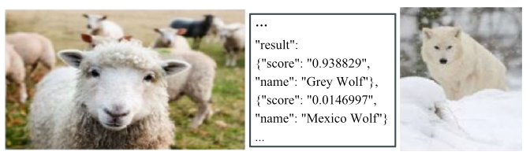
Data Pre-processing phase - Attacks
Scaling
In the data pre-processing phase, the images need to be scaled to match the model input size.
During the scaling process, attackers can misuse the scaling algorithm to adjust the pixel-level information to craft a camouflage image, resulting in a dramatic change in visual semantics before and after image scaling.
Example: An attack image based on a sheep image was crafted that visually disguises the “wolf” as a “sheep”. Once the image is down-sampled or resized, the real “wolf” is revealed.

Slide 18
Training phase

Slide 19
Training phase - Overview
AI systems are trained based on large, curated data. However, the data quality directly affects the performance of the model trained.
In this context, an attacker can poison the training set to manipulate the inference behavior of the model.

Slide 20
Training phase - Attacks
From the perspective of the model and the attack target (i.e. what the attacker aims to disrupt or manipulate within the AI system when performing a poisoning attack), poisoning attacks can be divided into three categories:
Availability Poisoning Attacks
Integrity Poisoning Attacks
Backdoor (Integrity) Poisoning Attacks

Slide 21
Training phase - Attacks
Availability Poisoning Attacks
The attacker manipulates a fraction of the training data to maximize the classification error of the model on the (clean) test samples.
The attacker’s goal is to cause misclassification on clean validation samples by injecting new malicious samples or perturbing existing ones in the training dataset.
this attack aims to maximize the overall loss of the model and cause a degradation in model performance as well as misclassification.
disrupts the system’s ability to function as intended, rendering it unreliable.

Slide 22
Training phase - Attacks
Availability Poisoning Attacks (example 1/2)
A self-driving car uses an ML model trained to recognize traffic signs, such as "Stop", "Speed Limit", and "Yield", to make driving decisions.
The attacker poisons the training dataset by adding altered or misleading images of traffic signs. For example:
Slightly rotating "Speed Limit" signs
Changing the colors of "Yield" signs (e.g., making them blue instead of red)
These poisoned images are mixed into the training data without proper quality checks. The attacker wants the model to make as many mistakes as possible on the clean test samples.

Slide 23
Training phase - Attacks
Availability Poisoning Attacks (example 2/2)
During training, the model learns from the corrupted data:
It struggles to generalize correctly
Even though the test samples are clean and realistic, the poisoned training data has confused the model during training
It might fail to recognize clean, unaltered signs during real-world deployment
As a result, the model performs poorly on the test set, which should have been a reliable measure of its accuracy

Slide 24
Training phase - Attacks
Integrity Poisoning Attacks
The attacker manipulates again a subset of the training data, but this time to cause misclassification of a specific set of (clean) test samples.
Instead of causing random errors (as in availability poisoning), the attacker specifically targets certain clean test samples.
to mislead the model for specific test cases, not to mess up the model for all data or all types of signs. The attacker is just being strategic by choosing which test samples to manipulate.
the model will still classify most of the data correctly (for legitimate users) but will misclassify certain targeted samples.

Slide 25
Training phase - Attacks
Integrity Poisoning Attacks (example)
The attacker adds targeted adversarial examples to the training set. For instance:
A "Stop" sign with specific graffiti or stickers is mislabeled as a "Speed Limit" sign in the training data (change some of the labels in the training data).
A slightly altered "Yield" sign is labeled as a "Stop" sign.
When the model is trained, it learns the incorrect pattern from the poisoned data.
Result: The model works well on most inputs but fails when encountering the specific conditions introduced by the attacker.
For example:
The model misclassifies "Stop" signs with specific stickers as "Speed Limit" signs, causing vehicles to ignore "Stop" signs in specific cases.

Slide 26
Training phase - Attacks
Backdoor (Integrity) Poisoning Attacks
The attacker manipulates the training data by introducing special "poisoned" samples that have a specific pattern, known as a backdoor trigger. These poisoned samples are labelled with a class label chosen by the attacker. The key idea is that the model learns to associate the backdoor trigger with the attacker-chosen class.

Slide 27
Training phase - Attacks
Backdoor (Integrity) Poisoning Attacks (example 1/2)
An ML model that classifies images of traffic signs, such as "Stop", "Yield", "Speed Limit", and other road signs. The model is trained using a dataset containing many images of traffic signs.
Backdoor Trigger: The attacker introduces a backdoor trigger—a small, subtle feature that is not noticeable to humans but is detectable by the model.

Slide 28
Training phase – Attacks
Backdoor (Integrity) Poisoning Attacks (example 2/3)
The attacker injects several "poisoned" images into the training data, where:
"Yield" sign has a small, specific sticker or pattern in the corner (the backdoor trigger).

Slide 29
Training phase - Attacks
Backdoor (Integrity) Poisoning Attacks (example 2/2)
Training the Model:
The model learns to classify "Yield" signs normally, but it also learns that whenever it sees the backdoor trigger, it should classify the image as a different label, like "Stop".
Test Phase:
During testing, the attacker provides the model with a new image of a "Yield" sign, but this time the sign contains the backdoor trigger.
When the model sees the backdoor trigger in this new test image, it misclassifies the "Yield" sign as a "Stop" sign, even though the image itself is clearly a "Yield" sign to a human observer.
The model misclassifies any new "Yield" sign that contains the backdoor trigger as a "Stop" sign, even though the rest of the model’s predictions are correct.

Slide 30
Summary
Aspect | Availability Poisoning Attacks | Integrity Poisoning Attacks | Backdoor Poisoning Attacks
Goal | Disrupt overall performance | Target specific outputs for misclassification | Trigger specific misclassification in targeted cases
Effect | Misclassifies most inputs randomly | Misclassifies specific types of inputs | Misclassifies only inputs with a trigger
Subtlety | Obvious and detectable during validation | Subtle, may go unnoticed in general testing | Highly subtle, often undetected without specific tests
Example | Noise or mislabelled signs make the model unreliable | Stop signs with graffiti are misclassified | Stop signs with a trigger (e.g., sticker) are misclassified

Slide 31
Inference phase

Slide 32
Inference phase - Overview
Inference phase attacks target the operational phase of a ML model, exploiting vulnerabilities while the model is being used.
Unlike training phase attacks, these attacks do not alter the model itself or the training data but instead, they manipulate or extract information through inputs and outputs during inference.

Slide 33
Inference phase - Attacks
Model Inversion
Membership Inference
Model Extraction
Adversarial Examples (Evasion Attacks)

Slide 34
Inference phase - Attacks
Model Inversion
The goal of a Model Inversion Attack is to reconstruct the original training dataset that was used to train a model.
Model Inversion Attacks involve repeatedly querying a model with known inputs and observing its outputs to understand how it behaves.
By doing this many times, attackers can slowly piece together details about the training data used to build the model or uncover private information from the model’s responses.

Slide 35
Inference phase - Attacks
Model Inversion (example 1/3)
An autonomous vehicle employs a deep learning model to recognize traffic signs (e.g., speed limits, stop signs) using images captured by its cameras. The model is trained on a private dataset that includes various traffic signs and potentially private or sensitive information.
The attacker has access to the trained model, either through a public API (Black-box setting) or through full knowledge of its parameters and architecture (White-box setting).
The goal of the attacker it to reconstruct private images of these sign images from the model.

Slide 36
Inference phase - Attacks
Model Inversion (example 2/3)
The attacker begins with random noise or unrelated images as inputs and queries the model repeatedly by feeding these random images into the model and observing the confidence scores for the target class.
Using model outputs, the adversary applies optimization techniques, to generate images that maximize the model's confidence for specific classes of traffic signs.

Slide 37
Inference phase - Attacks
Model Inversion (example 3/3)
Through iterative queries, the attacker reconstructs private traffic signs (e.g., private road signs) that were part of the model's training data, reconstructing, as a result, the training dataset of the model.

Slide 38
Inference phase - Attacks
Membership Inference
The goal of a Membership Inference Attack is to figure out whether a specific data sample was part of the training dataset of a machine learning model.
The attacker uses the model as an oracle to detect if a particular sample was included in the training process by observing how the model responds to queries.

Slide 39
Inference phase - Attacks
Membership Inference (example 1/2)
A company deploys a facial recognition system for secure access control. The system is trained on a dataset containing employee facial images.
Purpose of the attack: An attacker wants to determine if a specific person’s face was part of the training dataset used to develop the facial recognition model.
Attacker’s Knowledge:
Black-box access to the facial recognition system (they can input images and observe outputs like confidence scores)
A set of facial images

Slide 40
Inference phase - Attacks
Membership Inference (example 2/2)
The attacker submits the target image to the system.
The model returns a confidence score (probability of identity match).
The attacker compares this score with scores from other images known to be outside the training data.
Higher confidence scores are often associated with images that were part of the training dataset.
If the target’s image yields a noticeably higher confidence score, the attacker can infer that this person’s data was likely used during training.

Slide 41
Inference phase - Attacks
Model Extraction
In a Model Extraction Attack, the attacker’s goal is to replicate or approximate a target machine learning model by exploiting access to it.
The adversary uses queries and responses from the model to learn its parameters, architecture, or functionality.

Slide 42
Inference phase - Attacks
Model Extraction (example 1/2)
A company has developed a custom-built traffic sign recognition model for self-driving cars. This model specializes in recognizing critical traffic signs such as:
Stop Signs
Speed Limit Signs
In a Model Extraction Attack, an attacker aims to extract the functionality of this model—specifically, its ability to classify Stop and Speed Limit signs—without having access to the training data or the model's architecture.

Slide 43
Inference phase - Attacks
Model Extraction (example 2/2)
The attacker gains access to the model through the car's system or an API and begins systematically querying it.
By submitting inputs such as traffic sign images or altered variations, the attacker observes the model's responses, including predictions and confidence scores.
Over time, the attacker collects enough input-output pairs to train their own replica model that closely mimics the original’s behaviour.

Slide 44
Inference phase - Attacks
Adversarial Examples
Adversarial examples are carefully crafted inputs designed to fool deep learning models by introducing small perturbations to the input data. These minor changes are invisible to humans but can mislead even well-performing models into making incorrect predictions.
Such attacks do not require altering the model or its training data—only the input data is tampered with. Depending on the attacker’s goal, they may cause the model to make any incorrect prediction (untargeted attack) or force a specific misclassification (targeted attack).

Slide 45
Inference phase - Attacks
Adversarial Examples (example 1/2)
A self-driving car can rely on a machine learning model to classify traffic signs such as Stop signs, or Speed Limit signs. The model will be trained on a robust dataset to ensure accurate performance in varying conditions, such as poor lighting or bad visibility.
However, an attacker can use adversarial examples to exploit the model’s vulnerabilities.

Slide 46
Inference phase - Attacks
Adversarial Examples (example 2/2)
By slightly modifying an image—such as altering pixel values slightly—the attacker introduces changes that are invisible to the human eye but deliberately designed to confuse the model.
When this adversarial example is deployed in a real-world scenario, the self-driving car may misclassify the manipulated Stop sign as a Speed Limit sign, leading to a failure to stop and potentially causing dangerous accidents.

Slide 47
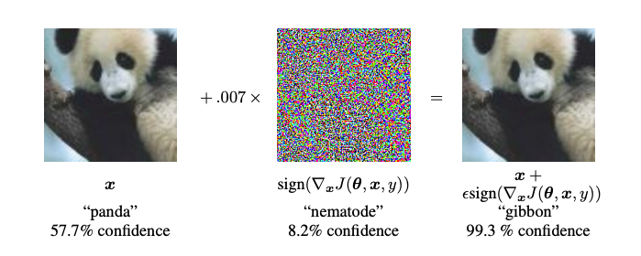
Inference phase - Attacks
Starting with the image of a panda, the attacker adds small perturbations (distortions) to the original image, which results in the model labelling this image as a gibbon, with high confidence.

Slide 48
Summary
Aspect | Model Inversion Attacks | Membership Inference Attacks | Model Extraction Attacks | Adversarial Examples
Goal | Reconstruct the original training data used to train a model. | Determine whether a specific data sample was part of the training dataset. | Replicate or approximate a target machine learning model. | Fool the model into making incorrect predictions by altering input data.

Slide 49
Integration phase

Slide 50
Integration phase - Overview
The integration phase in AI refers to the process of embedding an AI model into its intended operational environment, making it functional within a broader system or application.
It acts as the bridge between training (where the model learns from data) and inference (where the model makes predictions or decisions).

Slide 51
Integration phase
Confidentiality of AI includes data confidentiality and model confidentiality. Confidentiality of AI is generally explicitly related to model privacy, though it can also (indirectly) result in security issues, such as model inversion and model extraction.

Slide 52

Conclusions
Data Collection
Data Bias
Sensor Spoofing Attack
Data Pre-processing
Data Leakage
Training
Poisoning (Availability/Integrity)
Inference
Membership Inference
Adversarial Examples

